Slide 1
Stress Effects on Statistical Learning
Jan 2021

Slide 2
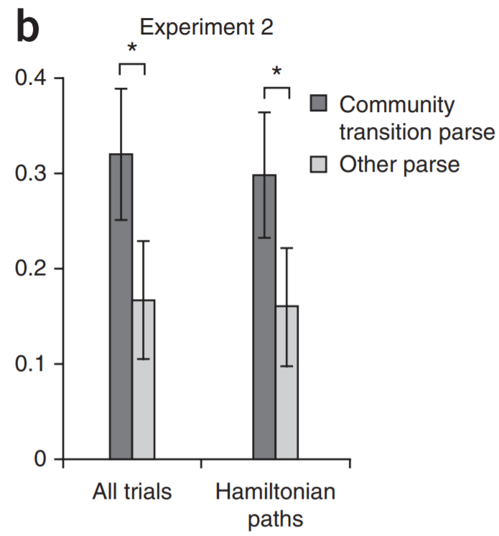
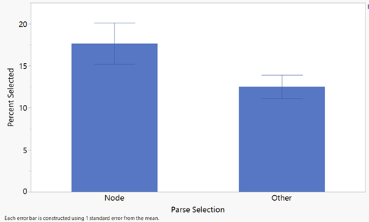
p= 0.038 between node and all other parse selections (for the control group participants specifically)
Trend of implicit learning in control group, though smaller effect than original study

Slide 3
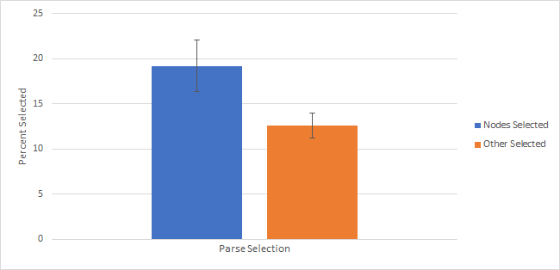

Slide 4
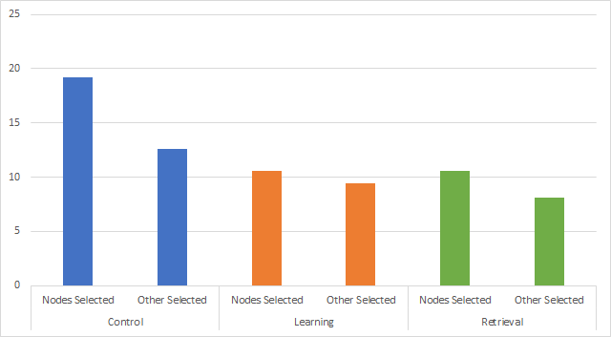

Slide 5
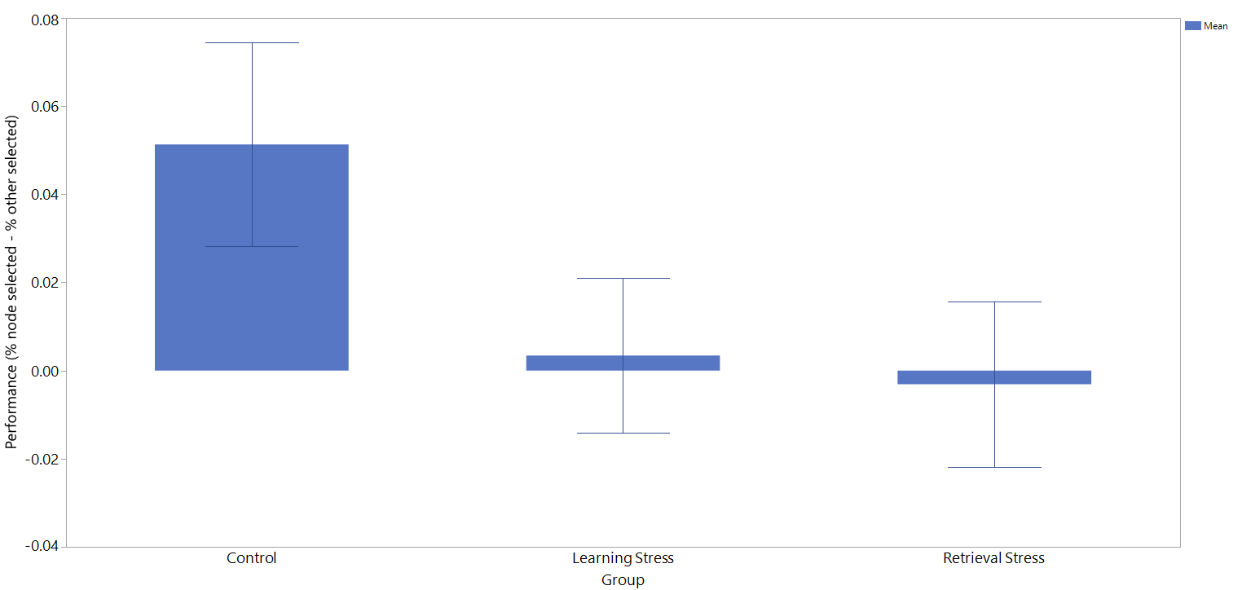

Slide 6
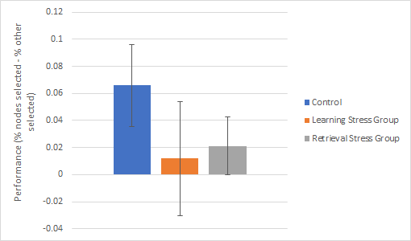

Slide 7
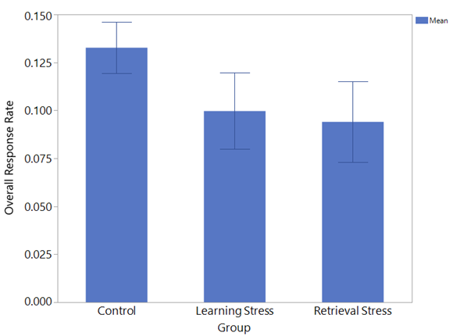
Notes:
Overall response rates of each group in the study. Appears it may be lower in the stress groups, but not statistically significant with the current sample.

Slide 8
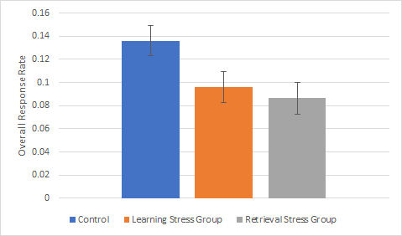

Slide 9
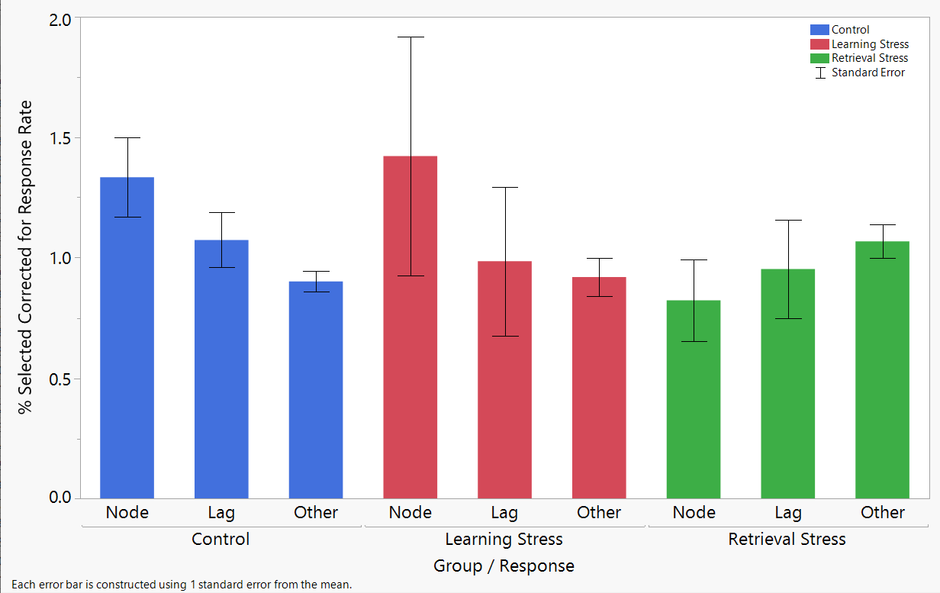
*Not sure how to make this with correcting for response rate*

Slide 10
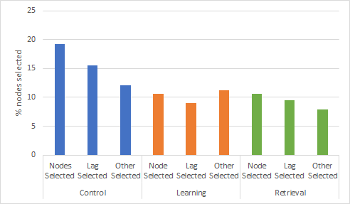

Slide 11
References
1. Schapiro, A. C., Rogers, T. T., Cordova, N. I., Turk-Browne, N. B., & Botvinick, M. M. (2013). Neural representations of events arise from temporal community structure. Nature neuroscience, 16(4), 486.
2. Schapiro, A. C., Turk-Browne, N. B., Botvinick, M. M., & Norman, K. A. (2017). Complementary learning systems within the hippocampus: a neural network modeling approach to reconciling episodic memory with statistical learning. Philosophical Transactions of the Royal Society B: Biological Sciences, 372(1711), 20160049.
3. Schapiro, A. C., Gregory, E., Landau, B., McCloskey, M., & Turk-Browne, N. B. (2014). The necessity of the medial temporal lobe for statistical learning. Journal of cognitive neuroscience, 26(8), 1736-1747.
4. Gagnon, S. A., Waskom, M. L., Brown, T. I., & Wagner, A. D. (2018). Stress impairs episodic retrieval by disrupting hippocampal and cortical mechanisms of remembering. Cerebral cortex (New York, NY: 1991).

